Slide 1
PDU Session Establishment
陳毅
Credit：陳煜盛

Slide 2
General
A PDU Session establishment may correspond to:
a UE initiated PDU Session Establishment procedure.
a UE initiated PDU Session handover between 3GPP and non-3GPP.
a UE initiated PDU Session handover from EPS to 5GS.
a Network triggered PDU Session Establishment procedure.
Notes:
PDU Session Establishment 有以下幾種:
- a UE initiated PDU Session Establishment procedure.
- a UE initiated PDU Session handover between 3GPP and non-3GPP.
a UE initiated PDU Session handover from EPS to 5GS.
a Network triggered PDU Session Establishment procedure

Slide 3
General
If the UE is simultaneously registered to a non-3GPP access via a N3IWF/TNGF/W-AGF located in a PLMN different from the PLMN of the 3GPP access, the functional entities in the following procedures are located in the PLMN of the access used to exchange NAS with the UE for the PDU Session.
Notes:
如果 UE 也同時透過 N3IWF/TNGF/W-AGF 註冊到 non-3GPP access 並且 PLMN 的位置與 3GPP access 不同，那麼接下來所描述的 procedures 的 functional entities 將會是與 UE 交換 NAS message 的那個 PLMN。

Slide 4
General
As specified in clause 5.6.1 of TS 23.501, a PDU Session may be associated either
(a) with a single access type at a given time, i.e. either 3GPP access or non-3GPP access, or
(b) simultaneously with multiple access types, i.e. one 3GPP access and one non-3GPP access. A PDU Session associated with multiple access types is referred to as Multi Access-PDU (MA-PDU) Session and it may be requested by ATSSS-capable UEs.
Notes:
根據 TS 23.501 5.6.1 節所定義，PDU Session 可能會是
Single access type; 或是
Multiple access types; 在 這種情況下會被稱為 multiple access-PDU (MA-PDU) 並且會由支援 ATSSS 的 UE 發起請求。
ATSSS: Access Traffic Steering, Switching and Splitting

Slide 5
UE Requested PDU Session Establishment
Notes:
接下來要說明的部分都是針對 UE Requested PDU Session Establishment

Slide 6
Non-roaming and Roaming with Local Breakout
In the case of roaming, the AMF determines if a PDU Session is to be established in
LBO (Local Breakout) or
Home Routing
In the case of LBO, the procedure is as in the case of non-roaming with the difference that the AMF, the SMF, the UPF and the PCF are located in the visited network.
PDU Sessions for Emergency services are never established in Home Routed mode.
NOTE: UE provides both the S-NSSAIs of the Home PLMN and Visited PLMN
Notes:
在 roaming 的情況下，AMF 會決定 PDU Session 的建立是要以 LBO (Local Breakout) mode 還是以 Home Routing mode。
在 LBO 的 case 下，procedure 幾乎都與 non-roaming case 差不多，差別就只有 AMF, SMF, UPF, PCF 位於 visited network。
PDU Session 針對 Emergency services 不會以 Home Routed mode 建立。
注意: UE 會同時提供 Home 及 Visited 的 PLMN

Slide 7
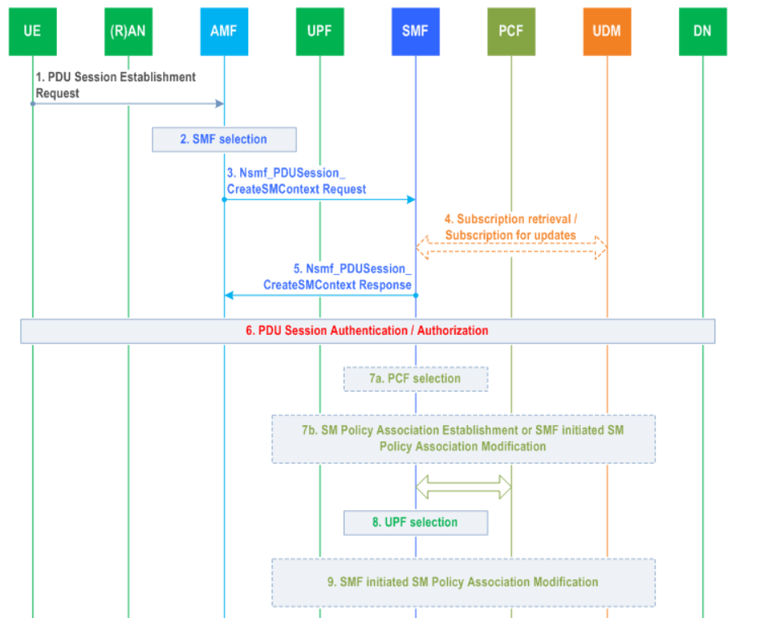
Notes:
這是 PDU Session Establishment 的 flow，總共有 21 步

Slide 8
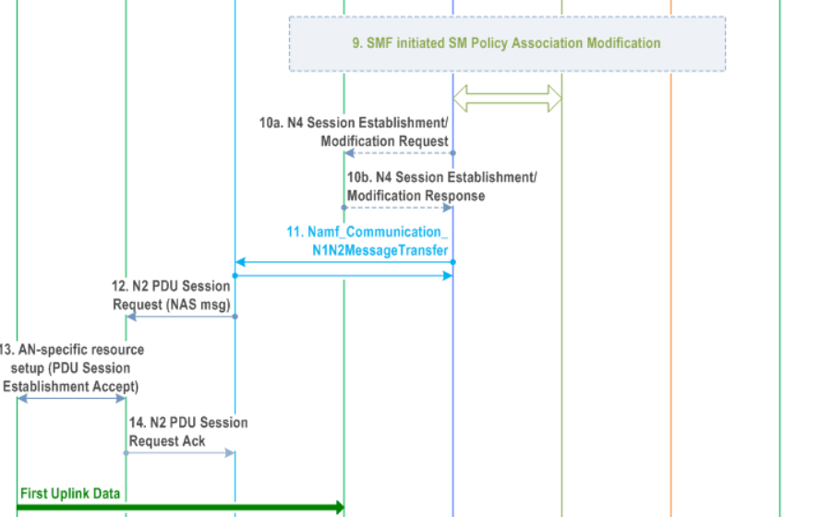

Slide 9
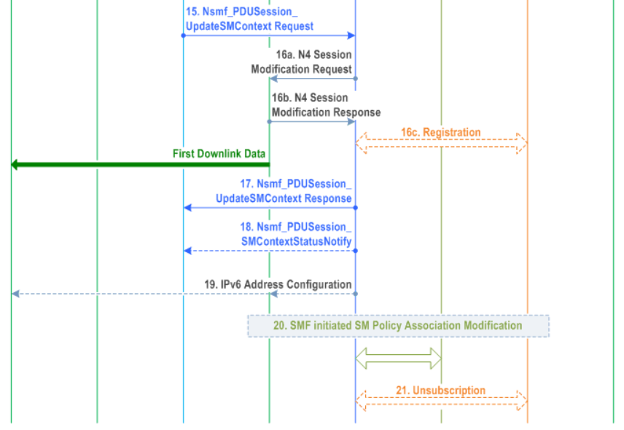

Slide 10
UE-requested PDU Session Establishment
The procedure assumes that the UE has already registered on the AMF thus unless the UE is Emergency Registered the AMF has already retrieved the user subscription data from the UDM.
Notes:
這個 procedure 假設 UE 已經註冊到 AMF ，因此除非 UE 是 Emergency Registered，AMF 已經從 UDM 獲取了 User subscription data。

Slide 11
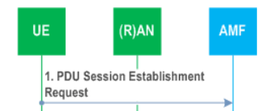
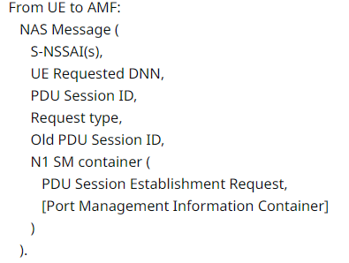
Step 1.
Notes:
首先，步驟一是 UE 傳送一個 PDU Session Establishment Request 給 AMF 透過 NAS，裡面包含:
S-NSSAI(s),
UE Requested DNN,
PDU Session ID,
Request type, Old PDU Session ID, N1 SM container (
PDU Session Establishment Request, [Port Management Information Container]
)

Slide 12
Step 1.
In order to establish a new PDU Session, the UE generates a new PDU Session ID.
Notes:
為了建立新的 PDU Session，UE 必須產生一個新的 PDU Session ID。

Slide 13
Step 1.
Request Type | indicates
Initial request | If the PDU Session Establishment is a request to establish a new PDU Session and indicates
Existing PDU Session | If the request refers to - an existing PDU Session switching between 3GPP and non-3GPP access or - a PDU Session handover from an existing PDN connection in EPC.
Emergency Request | When Emergency service is required and an Emergency PDU Session is not already established
Existing Emergency PDU Session | an existing PDU Session for Emergency services switching between 3GPP access and non-3GPP access or to a PDU Session handover from an existing PDN connection for Emergency services in EPC.
Notes:
Request Type 有以下四種:
1. Initial request: 如果此請求是要建立全新的 PDU Session
2. Existing PDU Session: 如果 request 是關於:
已經存在的 PDU Session 要從 3GPP switch 到 non-3GPP access; 或是
一個 PDU Session handover 從 EPC 的 PDN connection
3. Emergency Request: 當 Emergency service 有需求並且 Emergency PDU Session 尚未被建立
4. Existing Emergency PDU Session: 當存在一個為了 Emergency service 而已經建立的 PDU Session 並且要在 3GPP 與 non-3GPP 間切換，或是為了從 EPC 的 PDN connection for Emergency services 進行 PDU Session handover

Slide 14
Step 1.
The UE initiates the UE Requested PDU Session Establishment procedure by the transmission of a NAS message containing a PDU Session Establishment Request within the N1 SM container.
Notes:
UE 透過傳送一個包含 PDU Session Establishment Request 的 NAS message 於 N1 SM Container，啟動 UE 的 PDU Session Establishment Procedure。

Slide 15
Step 1.
The PDU Session Establishment Request includes:
PDU session ID,
Requested PDU Session Type
a Requested SSC mode
5GSM Capability
PCO (Protocol Configuration Options)
SM PDU DN Request Container
[Number Of Packet Filters]
[Header Compression Configuration]
UE Integrity Protection Maximum Data Rate
[Always-on PDU Session Requested]
[RSN]
[Connection Capabilities]
[PDU Session Pair ID]
Notes:
PDU Session Establishment Request 包含了:
PDU session ID,
Requested PDU Session Type
a Requested SSC mode
5GSM Capability
PCO (Protocol Configuration Options)
SM PDU DN Request Container
[Number Of Packet Filters]
[Header Compression Configuration]
UE Integrity Protection Maximum Data Rate
[Always-on PDU Session Requested]
[RSN]
[Connection Capabilities]
[PDU Session Pair ID]

Slide 16
Step 1.
Number Of Packet Filters
the number of supported packet filters for signalled QoS rules for the PDU Session that is being established.
The number of packet filters indicated by the UE is valid for the lifetime of the PDU Session.
Notes:
Number Of Packet Filters 這個欄位定義了，packet filters for signaled QoS rule 最大可被建立的數量
此 packet filters 的數量在 PDU Session 的完整生命週期都是有效的

Slide 17
Step 1.
UE Integrity Protection Maximum Data Rate
The maximum data rate up to which the UE can support UP integrity protection.
The UE shall provide it independently of the Access Type over which the UE sends the PDU Session Establishment Request.
Notes:
UE Integrity Protection Maximum Data Rate 這個欄位定義了 UE 在 User plane integrity protection 的環境下所支援的 maximum data rate。
UE 必須要根據不同的 Access Type 提供不同的 UE Integrity Protection Maximum Data Rate

Slide 18
Step 1.
Header Compression Configuration
If the use of header compression for Control Plane CIoT 5GS optimisation was negotiated successfully between the UE and the network in the previous registration procedure, the UE shall include it, unless "Unstructured" PDU Session Type is indicated.
It includes the information necessary for the header compression channel setup.
Optionally, it may include additional header compression context parameters.
Notes:
Header Compression Configuration 這個欄位是當 UE 與核網在先前的 Registration procedure 有約定好要做 header compression for Control Plane CIoT 5GS optimisation，除非是 “Unstructured” PDU Session Type，否則 UE 應該要包含這項設定。
它包含了 header compression channel setup 的必要資訊。
選擇性地，它可能包含額外的 header compression context parameters。

Slide 19
Step 1.
The PDU Session Establishment Request message may contain SM PDU DN Request Container containing information for the PDU Session authorization by the external DN.
Notes:
PDU Session Establishment Request 可能會包含 SM PDU DN Request Container，裡面包含了被其他 DN 授權的 PDU Session 的相關資訊。

Slide 20
Step 1.
The NAS message sent by the UE is encapsulated by the AN in a N2 message towards the AMF that should include
User location information
Access Type Information
Notes:
NAS message 會被 AN 封裝變成 N2 message 傳送到 AMF，並且應該包含 User location information 及 Access Type Information

Slide 21
Step 1.
The UE includes the S-NSSAI from the Allowed NSSAI of the current access type.
If the Mapping of Allowed NSSAI was provided to the UE, the UE shall provide both
the S-NSSAI of the VPLMN from the Allowed NSSAI and
the corresponding S-NSSAI of the HPLMN from the Mapping Of Allowed NSSAI.
Notes:
UE 會根據 Allowed NSSAI 將 S-NSSAI 包進目前的 access type 的 NAS Message。
如果 Mapping of Allowed NSSAI 有提供給 UE 則 UE 應該要同時提供
the S-NSSAI of the VPLMN from the Allowed NSSAI 以及
the corresponding S-NSSAI of the HPLMN from the Mapping Of Allowed NSSAI.

Slide 22
Step 1.
If the procedure is triggered for SSC mode 3 operation, the UE shall also include the Old PDU Session ID which indicates the PDU Session ID of the on-going PDU Session to be released, in NAS message.
The Old PDU Session ID is included only in this case.
Notes:
如果此 procedure 是要觸發 SSC mode 3，則 UE 應該將舊的 PDU Session ID 包含進 NAS message，顯示正在進行的 PDU Session 來並且對它進行釋放。
Old PDU Session ID 只有在此情況下會被包含進 NAS message。

Slide 23
Step 1.
The AMF receives from the AN
the NAS SM message (built in step 1) together with
User Location Information (e.g. Cell Id in the case of the NG-RAN).
The UE shall not trigger a PDU Session establishment for a PDU Session corresponding to a LADN when the UE is outside the area of availability of the LADN.
Notes:
AMF 會從 AN 那裡收到 NAS SMS message 伴隨著 User Location Information (例如 cell id)。
若 UE 在 the area of availability of the LADN 外面， UE 不應該觸發 PDU Session establishment。

Slide 24
Step 1.
If the UE is establishing a PDU session for IMS and the UE is configured to discover the P-CSCF address during connectivity establishment, the UE shall include an indicator that it requests a P-CSCF IP address(es) within the SM container.
P-CSCF: Proxy - Call Session Control Function
Notes:
如果 UE 是為了 IMS 而建立 PDU session，並且 UE 被設定成在 Connectivity 建立的時候要尋找 P-CSCF 的 address ，則 UE 應該要包含 requests a P-CSCF IP address(es) 的 indicator 進 N1 SM container。

Slide 25
Step 1.
PCO (Protocol Configuration Options) may includes:
PS Data Off status
UE capability to support Reliable Data Service
the ability to receive ECS address(es) via NAS and to transfer the ECS Address(es) to the EEC(s). (TS 23.548)
EDC functionality (TS 23.548)
EAS re-discovery (TS 23.548)
Notes:
Protocol Configuration Options 縮寫 PCO，被包含在 PDU Session Establishment Request message。
PCO 包含了:
PS Data Off status
UE capability to support Reliable Data Service
UE 也可能會在 PCO 內包含 UE 自身透過 NAS 接收/傳送 ECS address 的能力。(TS 23.548)
EDC functionality (TS 23.548)
EAS re-discovery (TS 23.548)
The PS Data Off feature can be activated from the UE side. As all services are over PDU sessions, this gives users the ability to turn off all data services.
EEC: Edge Enabler Client
ECS: Edge Configuration Server
EDC: Edge DNS Client
EAS: Edge Application Server

Slide 26
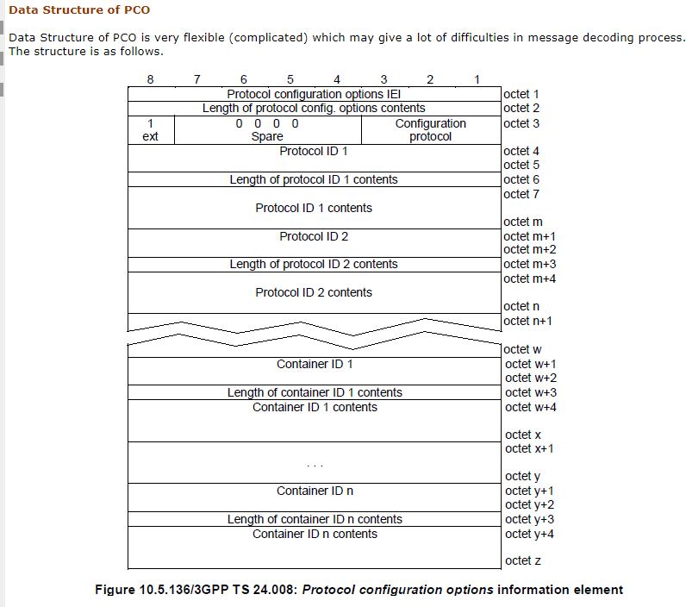
PCO
https://www.sharetechnote.com/html/Handbook_LTE_ProtocolConfigurationOption.html

Slide 27
Step 1.
If the UE has indicated that it supports transfer of Port Management Information Containers as per UE 5GSM Core Network Capability and if the PDU session type is Ethernet, then the UE shall include the MAC address of the DS-TT Ethernet port used for this Ethernet PDU session.
If the UE is aware of the UE-DS-TT Residence Time, then the UE shall additionally include it.
DS-TT: Device-Side Time Sensitive Networking (TSN) Translator
Notes:
如果 UE 顯示它支援 Port Management Information Containers as per UE 5GSM Core Network Capability 並且如果 PDU session type 是 Ethernet，則
UE 應該要針對此 Ethernet PDU session 包含 MAC address of the DS-TT Ethernet port。
如果 UE 感受到了 UE-DS-TT Residence Time，則 UE 必須額外包含 UE-DS-TT Residence Time
DS-TT: Device-Side Time Sensitive Networking (TSN) Translator

Slide 28
Step 1.
If the UE requests to establish always-on PDU session, the UE includes an Always-on PDU Session Requested indication in the PDU Session Establishment Request message.
If UE supports to report URSP rule enforcement to network, the UE may provide Connection Capabilities.
Notes:
如果 UE 要請求建立 always-on PDU session，它會包含 Always-on PDU Session Requested indication 在 PDU Session Establishment Request message 裡面。
如果UE支援向網路回報 URSP（User-Reported Service Problem）rule enforcement，則 UE 可以提供 Connection Capabilities。
URSP 幫助核心網路理解 Application 與網路切片的關聯性，透過URSP，終端設備可以為不同的應用選擇不同的網路切片，滿足每個可能的應用場景。

Slide 29
Step 2 (new PDU Session case)
The AMF determines that the message corresponds to a request for a new PDU Session based on that Request Type indicates "initial request" and that the PDU Session ID is not used for any existing PDU Session of the UE.
If the NAS message does not contain an S-NSSAI, the AMF determines an S-NSSAI of the Serving PLMN for the requested PDU Session from the current Allowed NSSAI for the UE. If there is only one S-NSSAI in the Allowed NSSAI, this S-NSSAI shall be used.
Notes:
步驟2 為 SMF Selection，AMF 會決定這是一個新的 PDU Session Request 根據 Request Type 顯示 initial request 並且 PDU Session ID 沒有被任何已存在的 PDU Session 使用。
如果 NAS message 沒有包含 S-NSSAI，AMF 自行決定 PLMN 的 S-NSSAI ，根據目前 UE 的 Allowed NSSAI。如果只有一組 S-NSSAI 在 Allowed NSSAI，這個 S-NSSAI 應該要被使用。

Slide 30
Step 2 (new PDU Session case)
If there is more than one S-NSSAI in the Allowed NSSAI, the S-NSSAI selected is either
according to the UE subscription, if the subscription contains only one default S-NSSAI and the corresponding mapped HPLMN S-NSSAI of the Serving PLMN is included in the Allowed NSSAI , or
based on operator policy (e.g. also ensures any UE Requested DNN is allowed for the selected S-NSSAI))
Notes:
如果有大於一組的 S-NSSAI 在 Allowed NSSAI，這個 S-NSSAI 的選擇會是以下其一:
根據 UE subscription，如果 subscription 只包含了一個 default S-NSSAI 以及相對應的 mapped HPLMN S-NSSAI of the Serving PLMN 被包含在 Allowed NSSAI; 或是
根據 operator 的政策 (這也確保了任何 UE 請求的 DNN 會被選到的 S-NSSAI 所允許)

Slide 31
Step 2 (new PDU Session case)
When the NAS Message contains an S-NSSAI of the Serving PLMN but it does not contain a DNN,
the AMF determines the DNN for the requested PDU Session by selecting the default DNN for this S-NSSAI if the default DNN is present in the UE's Subscription Information (or for the corresponding S-NSSAI of the HPLMN, in the case of LBO); otherwise
the serving AMF selects a locally configured DNN for this S-NSSAI of the Serving PLMN.
Notes:
當 NAS message 包含 S-NSSAI of the Serving PLMN 但不包含 DNN:
AMF 會選擇這個 S-NSSAI 的 default DNN (前提是 UE 的 Subscription Information 有提供這個 Default DNN，或是 corresponding S-NSSAI of the HPLMN 在 LBO case); 否則
Serving AMF 會選擇本地設定的 DNN 給這個 S-NSSAI of the Serving PLMN

Slide 32
Step 2 (new PDU Session case)
If the AMF cannot select an SMF, e.g.
the UE requested DNN is not supported by the network, or
the UE requested DNN is not in the Subscribed DNN List for the S-NSSAI (or its mapped value for the HPLMN in the case of LBO) and wildcard DNN is not included in the Subscribed DNN list,
the AMF shall, based on operator policies received from PCF, either
reject the NAS Message containing PDU Session Establishment Request from the UE with an appropriate cause; or
request PCF to replace the UE requested DNN by a selected DNN.
Notes:
如果 AMF 不能選擇 SMF，例如:
UE 請求的 DNN 不被 network 支援，或
UE 請求的 DNN 不在 Subscribed DNN List for the S-NSSAI，並且 Subscribed DNN list 沒有包含 wildcard DNN。
AMF 應該要基於 PCF 的 operator policies
拒絕 NAS Message 並附上合適的 cause; 或
請求 PCF 用 selected DNN 取代 UE requested DNN

Slide 33
Step 2 (new PDU Session case)
If the DNN requested by the UE is present in the UE subscription information but indicated for replacement in the operator policies received from PCF, the AMF shall request the PCF to perform a DNN replacement to a selected DNN.
AMF requests DNN replacement as specified in clause 4.16.2.1.1.
If the DNN requested by the UE is present in the UE subscription information but
not supported by the network and
not indicated for replacement in the operator policies received from PCF
=> the AMF shall reject the NAS Message containing PDU Session Establishment Request from the UE with an appropriate cause value.
Notes:
如果 UE 請求的 DNN 存在於 UE subscription information，但是因為 PCF 的 operator policies 顯示要進行 replacement，則 AMF 應該要請求 PCF 執行 DNN replacement 切換到 selected DNN。
AMF 請求 DNN replacement 的 procedure 被定義在 clause 4.16.2.1.1
如果 UE request 的 DNN 有在 UE subscription information 但是卻沒有被 Network 支援以及 PCF 沒有顯示要進行 DNN replacement，則 AMF 應該要拒絕此含有 PDU Session Establishment Request 的 NAS Message

Slide 34
Step 2 (new PDU Session case)
If the Request Type indicates "Initial request" or the request is due to handover from EPS or from non-3GPP access serving by a different AMF, the AMF stores an association of
the S-NSSAI(s)
the DNN
the PDU Session ID
the SMF ID
the Access Type
Notes:
若 Request Type 顯示為 Initial request 或這個 request 是從 EPS 或 non-3GPP access 那邊不同的 AMF 所 handover 過來的，AMF 會儲存這些資訊的關聯:
the S-NSSAI(s)
the DNN
the PDU Session ID
the SMF ID
the Access Type

Slide 35
Step 2 (new PDU Session case)
During registration procedures, the AMF determines the use of the Control Plane CIoT 5GS Optimisation or User Plane CIoT 5GS Optimisation based on
UEs indications in the 5G Preferred Network Behaviour
the serving operator policies
the network support of CIoT 5GS optimisations.
The AMF selects an SMF that supports
Control Plane CIoT 5GS optimisation or
User Plane CIoT 5GS Optimisation
as described in clause 6.3.2 of TS 23.501.
Notes:
在 registration procedures 過程中，AMF 會決定是否要使用 Control Plane 或 User Plane CIoT 5GS Optimisation 基於:
UEs indications in the 5G Preferred Network Behaviour
the serving operator policies
the network support of CIoT 5GS optimisations
AMF 會選擇支援 Control Plane 或 User Plane CIoT 5GS optimisation 的 SMF，這被描述在 clause 6.3.2 of TS 23.501

Slide 36
Step 2 (existing PDU Session case)
If the Request Type indicates "Existing PDU Session", the AMF selects the SMF based on SMF-ID received from UDM.
The case where the Request Type indicates "Existing PDU Session" and either
the AMF does not recognize the PDU Session ID or
the subscription context that the AMF received from UDM during the Registration or Subscription Profile Update Notification procedure does not contain an SMF ID corresponding to the PDU Session ID constitutes an error case.
The AMF updates the Access Type stored for the PDU Session.
Notes:
若 Request type 顯示 Existing PDU Session，AMF 選擇 SMF 基於從 UDM 收到的 SMF-ID。
這種 case 之下，在以下任一種狀況發生時，會構成 error case:
AMF 沒辦法認得 PDU Session ID; 或者
在 Registration 或 Subscription Profile Update Notification procedure 時，AMF 從 UDM 那裡得到的 Subscription context 並沒有包含對應到 PDU Session ID 的 SMF ID。
AMF 會更新 Access Type 並為此 PDU Session 儲存在 AMF 裡。

Slide 37
Step 2 (existing PDU Session case)
If the Request Type indicates "Existing PDU Session" referring to an existing PDU Session moved between 3GPP access and non-3GPP access, then if the Serving PLMN S-NSSAI of the PDU Session is present in the Allowed NSSAI of the target access type, the PDU Session Establishment procedure can be performed in the following cases:
the SMF ID corresponding to the PDU Session ID and the AMF belong to the same PLMN;
the SMF ID corresponding to the PDU Session ID belongs to the HPLMN;
Otherwise the AMF shall reject the PDU Session Establishment Request with an appropriate reject cause.
Notes:
若 Request Type 顯示為 “Existing PDU Session” 並且是一個已存在的 PDU Session 想在 3GPP/non-3GPP access 之間移動，那麼如果對於 target access type 而言 Serving PLMN S-NSSAI 在 Allowed NSSAI 內，則 PDU Session Establishment procedure 可以用分成以下的 case 執行: 分別是:
SMF ID 符合 PDU Session ID 並且 AMF 在 相同的 PLMN;
SMF ID 符合 PDU Session ID，並且此 PDU Session ID 屬於 HPLMN
若不是上述兩種，AMF 應該要拒絕 PDU Session Establishment Request 並附上適合的 reject cause。

Slide 38
Step 2 (existing PDU Session case)
The AMF shall reject a request coming from an Emergency Registered UE and the Request Type indicates neither "Emergency Request" nor "Existing Emergency PDU Session".
When the Request Type indicates "Emergency Request", the AMF is not expecting any S-NSSAI and DNN value provided by the UE and uses locally configured values instead. The AMF stores the Access Type of the PDU Session.
If the Request Type indicates "Emergency Request" or "Existing Emergency PDU Session", the AMF selects the SMF as described in clause 5.16.4 of TS 23.501.
Notes:
若 UE Request Type 不是 “Emergency Request” 也不是 “Existing Emergency PDU Session” 則 AMF 應該要拒絕 Emergency Registered UE
當 Request Type 顯示為 Emergency Request，AMF 不會期望收到任何 S-NSSAI 及 DNN 而是使用 locally configured values。
若Request Type 是 “Emergency Request” or “Existing Emergency PDU Session”，則 AMF 選擇 SMF 的 procedure 被描述在 clause 5.16.4 of TS 23.501

Slide 39
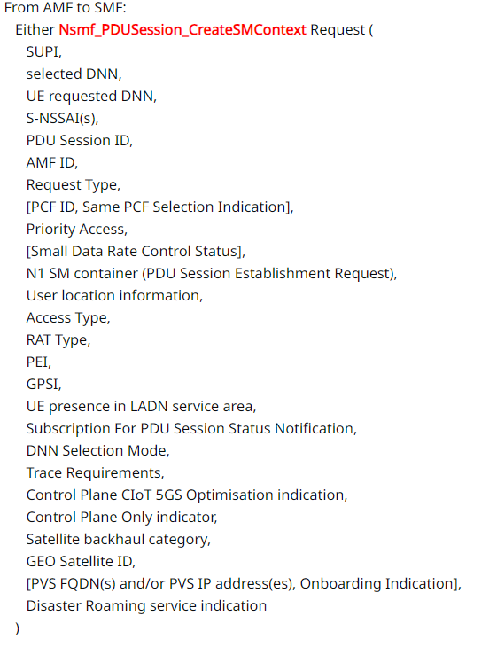
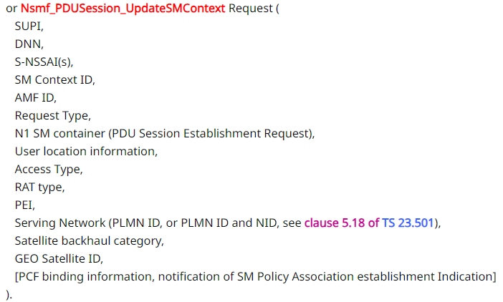
Step 3.
Notes:
步驟三是 AMF 傳給 SMF 的 Nsmf_PDUSession_CreateSMContext 或 Nsmf_PDUSession_UpdateSMContext Request。他們分別包含了以下資訊。

Slide 40
Step 3.
If the AMF does not have an association with an SMF for the PDU Session ID provided by the UE (e.g. when Request Type indicates "initial request"), the AMF invokes the Nsmf_PDUSession_CreateSMContext Request,
but if the AMF already has an association with an SMF for the PDU Session ID provided by the UE (e.g. when Request Type indicates "existing PDU Session"), the AMF invokes the Nsmf_PDUSession_UpdateSMContext Request.
Notes:
如果 AMF 與 SMF 之間沒有 UE 提供的 PDU Session ID 的 association，也就是說是 Initial request，AMF 會發起 Nsmf_PDUSession_CreateSMContext Request。
若有 association，也就是說是 existing PDU Session，則發起 Nsmf_PDUSession_UpdateSMContext Request。

Slide 41
Step 3.
The AMF sends the S-NSSAI of the Serving PLMN from the Allowed NSSAI to the SMF. For roaming scenario in local breakout (LBO), the AMF also sends the corresponding S-NSSAI of the HPLMN from the Mapping Of Allowed NSSAI to the SMF.
The AMF ID is the UE's GUAMI which uniquely identifies the AMF serving the UE. The AMF forwards the PDU Session ID together with the N1 SM container containing the PDU Session Establishment Request received from the UE. The GPSI shall be included if available at AMF.
Notes:
AMF 從 Allowed NSSAI 選出 S-NSSAI of the Serving PLMN 傳送給 SMF。在 LBO case，AMF 也會從 Mapping Of Allowed NSSAI 選出 corresponding S-NSSAI of the HPLMN 給 SMF。
AMF ID 是 UE 的 GUAMI。AMF 轉送 PDU Session ID 伴隨著 N1 SM container 包含了 PDU Session Establishment Request。如果 AMF 支援 GPSI 則也要被一起包含進去。
GPSI 可能為 MSISDN 或 External Identifier
(以下備註不用念)
The GPSI is used as a means of addressing a 3GPP subscription in data networks outside the realms of a 3GPP system. GPSIs are public identifiers such as a MSISDN or an External Identifier.

Slide 42
Step 3.
The AMF determines Access Type and RAT Type.
The AMF provides the PEI instead of the SUPI when the UE in limited service state has registered for Emergency services (i.e. Emergency Registered) without providing a SUPI.
If the UE in limited service state has registered for Emergency services (i.e. Emergency Registered) with a SUPI but has not been authenticated the AMF indicates that the SUPI has not been authenticated.
The SMF determines that the UE has not been authenticated when
it does not receive a SUPI for the UE or
when the AMF indicates that the SUPI has not been authenticated.
Notes:
AMF 會決定 Access Type 及 RAT Type
當 UE 在 limited service state 並且註冊到 Emergency services，則 AMF 提供 PEI 而不是 SUPI。
如果 UE 在 limited service state 並且註冊到 Emergency services，並且有提供 SUPI 但沒有被認證，則 AMF 會顯示這個 SUPI 是未經認證過的。
SMF 會斷定此 UE 沒有被認證，當:
它沒有收到 SUPI，或
當 AMF 顯示 SUPI 沒有被認證

Slide 43
Step 3.
If the AMF determines that the selected DNN corresponds to an LADN then the AMF provides the "UE presence in LADN service area" that indicates if the UE is IN or OUT of the LADN service area.
If the Old PDU Session ID is included in step 1 and if the SMF is not to be reallocated, the AMF also includes Old PDU Session ID in the Nsmf_PDUSession_CreateSMContext Request.
DNN Selection Mode is determined by the AMF. It indicates whether an explicitly subscribed DNN has been provided by the UE in its PDU Session Establishment Request.
The SMF may use DNN Selection Mode when deciding whether to accept or reject the UE request.
Notes:
如果 AMF 判斷 selected DNN 符合 LADN，則 AMF 提供 UE presence in LADN service area 欄位顯示 UE 是在 LADN service area 裡面還是外面。
如果舊的 Old PDU Session ID 被包含在 step1 並且 SMF 沒有要被 reallocated，則 AMF 也會 include Old PDU Session ID 在 Nsmf_PDUSession_CreateSMContext Request。
DNN Selection Mode 是被 AMF 決定。它顯示了是否一個 explicitly subscribed DNN 有被 UE 提供在 PDU Session Establishment Request
SMF 可以使用 DNN Selection Mode 來決定是否要 accept 或 reject UE request。

Slide 44
Step 3.
When the Establishment cause received as part of AN parameters during the Registration procedure or Service Request procedure is associated with priority services (e.g. MPS, MCX), or when the AMF determines the UE has priority subscription (e.g. MPS, MCX) in the UDM, the AMF includes a Message Priority header to indicate priority information. The SMF uses the Message Priority header to determine if the UE request is subject to exemption from NAS level congestion control. Other NFs relay the priority information by including the Message Priority header in service-based interfaces, as specified in TS 29.500.
Notes:
在 Registration 或 Service Request 期間，若 Establishment cause 是被包在 AN parameters 送過來並關連到 priority services 或當 AMF 判斷 UE 在 UDM 擁有 priority subscription ，AMF 包含 Message Priority header 來顯示 priority information。SMF 使用 Message Priority header 來決定是否 UE request 有在 NAS level congestion control 被優待。其他 NFs 則透過包含 Message Priority header在 SBI relay 這個 priority information 。

Slide 45
Step 3.
In the local breakout case, if the SMF (in the VPLMN) is not able to process some part of the N1 SM information that Home Routed Roaming is required and the SMF responds to the AMF that it is not the right SMF to handle the N1 SM message by invoking Nsmf_PDUSession_CreateSMContext Response service operation. The SMF includes a proper N11 cause code triggering the AMF to proceed with home routed case. The procedure starts again at step 2.
Notes:
在 LBO，如果 SMF 無法處裡 N1 SM information 的某些部份，需要使用 Home Routed Roaming，則 SMF 會告訴 AMF: 我並不是一個正確的 SMF 可以 handle N1 SM message 透過 Nsmf_PDUSession_CreateSMContext Response。
SMF 會包含適當的 N11 cause code 來觸發 AMF 進行 home routed case。Procedure 會跳回 step 2

Slide 46
Step 3.
In the non-roaming case, for PDU Session with Request Type "initial request", the AMF checks if the PCF Selection Assistance info from the UDM indicates that the same PCF is required for the requested DNN and S-NSSAI and if required, the AMF includes in Nsmf_PDUSession_CreateSMContext Request both the Same PCF Selection Indication and the PCF ID selected by the AMF, this PCF ID identifies the H-PCF,
If PCF Selection Assistance info is not received from the UDM, the AMF may include a PCF ID in the Nsmf_PDUSession_CreateSMContext Request based on operator policies. This PCF ID identifies the H-PCF in the non-roaming case and the V-PCF in the local breakout roaming case.
Notes:
在 non-roaming case，Request Type 為 initial request 的 PDU Session，AMF 從 UDM 那裡拿到的 PCF Selection Assistance info 會顯示是否為了 DNN 及 S-NSSAI 而需要相同的 PCF ，如果需要，則 AMF 包含 Same PCF Selection Indication 及 AMF 挑選的 PCF ID，這個 PCF ID 是 H-PCF。
如果沒有從 UDM 那邊收到 PCF Selection Assistance info，AMF 可能會根據 operator policies 將 PCF ID 包進 Nsmf_PDUSession_CreateSMContext Request，這個 PCF ID 在 non-roaming case 是 H-PCF，在 LBO case 是 V-PCF。

Slide 47
Step 3.
The AMF includes Trace Requirements if Trace Requirements have been received in subscription data.
Notes:
如果 Trace Requirements 有在 subscription data，AMF 會包含 Trace Requirements 進 Nsmf_PDUSession_CreateSMContext Request。

Slide 48
Step 3.
If the AMF decides to use the Control Plane CIoT 5GS Optimisation or User Plane CIoT 5GS Optimisation as specified in step 2 or to only use Control Plane CIoT 5GS Optimisation for the PDU session as described in clause 5.31.4 of TS 23.501, the AMF sends the Control Plane CIoT 5GS Optimisation indication or Control Plane Only indicator to the SMF.
Notes:
如果 AMF 決定使用步驟2定義的 Control Plane 或 User Plane CIoT 5GS Optimisation ，或選擇只使用 Control Plane CIoT 5GS Optimisation，AMF 傳送 Control Plane CIoT 5GS Optimisation indication 或 Control Plane Only indicator 給 SMF。

Slide 49
Step 3.
If the AMF determines that the RAT type is NB-IoT and the number of PDU Sessions with user plane resources activated for the UE has reached the maximum number of supported user plane resources (0, 1 or 2) based on whether the UE supports UP data transfer and the UE's 5GMM Core Network Capability as described in Clause 5.31.19 of TS 23.501, the AMF may either
reject the PDU Session Establishment Request or
continue with the PDU Session establishment and include the Control Plane CIoT 5GS Optimisation indication or Control Plane Only indicator to the SMF.
Notes:
如果 AMF 決定 RAT type 是 NB-IoT 並且 PDU Session 的數量對於 UE 已經達到 user plane resources 的上限(0,1, or 2)了，根據 UE 是否支援 UP data transfer 以及 UE‘s 5GMM Core Network Capability，AMF 會
Reject PDU Session Establishment Request 或
繼續 the PDU Session establishment 並且包含 Control Plane CIoT 5GS Optimisation indication 或 Control Plane Only indicator 給 SMF

Slide 50
Step 3.
The AMF includes the latest Small Data Rate Control Status if it has stored it for the PDU Session.
If the RAT type was included in the message, then the SMF stores the RAT type in SM Context.
Notes:
AMF 將它為 PDU Session 所儲存的 latest Small Data Rate Control Status 包含進 request
如果 RAT type 有被包含進 Nsmf_PDUSession_CreateSMContext Request 則 SMF 會儲存 RAT type 在 SM Context 內。

Slide 51
Step 3.
The remain of detail is skipped in this page.

Slide 52


Step 4.
If Session Management Subscription data for corresponding SUPI, DNN and S-NSSAI of the HPLMN is not available, then SMF retrieves the Session Management Subscription data using Nudm_SDM_Get (SUPI, Session Management Subscription data, selected DNN, S-NSSAI of the HPLMN, Serving PLMN ID, [NID]) and subscribes to be notified when this subscription data is modified using Nudm_SDM_Subscribe (SUPI, Session Management Subscription data, selected DNN, S-NSSAI of the HPLMN, Serving PLMN ID, [NID]).
UDM may get this information from UDR by Nudr_DM_Query (SUPI, Subscription Data, Session Management Subscription data, selected DNN, S-NSSAI of the HPLMN, Serving PLMN ID, [NID]) and may subscribe to notifications from UDR for the same data by Nudr_DM_subscribe.
Notes:
如果 Session Management Subscription data 對應到的 SUPI, DNN 及 S-NSSAI of the HPLMN 不可用，SMF 會使用 Nudm_SDM_Get 這個 API 從 UDM 那裡獲取 Session Management Subscription data 裡面包含 SUPI, Session Management Subscription data, selected DNN, S-NSSAI of the HPLMN, Serving PLMN ID, [NID]，並使用 Nudm_SDM_Subscribe (SUPI, Session Management Subscription data, selected DNN, S-NSSAI of the HPLMN, Serving PLMN ID, [NID]) 訂閱到 UDM，當有以上欄位的 subscription data 被修改時會被 UDM 通知。
UDM 可能會透過 Nudr_DM_Query (SUPI, Subscription Data, Session Management Subscription data, selected DNN, S-NSSAI of the HPLMN, Serving PLMN ID, [NID]) 從 UDR 獲取資訊，並且也會訂閱 UDR 透過 Nudr_DM_subscribe。

Slide 53
Step 4.
The SMF may use DNN Selection Mode when deciding whether to retrieve the Session Management Subscription data e.g. if the (selected DNN, S-NSSAI of the HPLMN) is not explicitly subscribed, the SMF may use local configuration instead of Session Management Subscription data.
Notes:
SMF 會使用 DNN Selection Mode 來決定是否要從 UDM 那獲取 Session Management Subscription data，例如 (selected DNN, S-NSSAI of the HPLMN) 沒有明確地被 UE 訂閱的時候，SMF 會使用 local configuration 而不是 Session Management Subscription data。

Slide 54
Step 4.
If the Request Type is ”Existing PDU Session” or ”Existing Emergency PDU Session” the SMF determines that the request is due to
switching between 3GPP access and non-3GPP access or
due to handover from EPS
The SMF identifies the existing PDU Session based on the PDU Session ID.
In such a case, the SMF does not create a new SM context but instead updates the existing SM context and provides the representation of the updated SM context to the AMF in the response.
Notes:
如果 Request Type 是 ”Existing PDU Session” or ”Existing Emergency PDU Session”，SMF 會決定這個 request 是因為 switching between 3GPP access and non-3GPP access 或 due to handover from EPS 而被請求。
SMF 會根據 DPU Session ID 識別已經存在的 PDU Session。
在這種 case 下，SMF 不會產生新的 SM context 但是會更新既有的 SM context，並在 response 的時候提供 representation of the updated SM context 給 AMF。

Slide 55
Step 4.
If the Request Type is "Initial request" and if the Old PDU Session ID is included in Nsmf_PDUSession_CreateSMContext Request, the SMF identifies the existing PDU Session to be released based on the Old PDU Session ID.
Notes:
如果 Request Type 是 Initial Request 並且 Old PDU Session ID 有被包含進 Nsmf_PDUSession_CreateSMContext Request，則 SMF 會根據 Old PDU Session ID 識別 existing PDU Session 並且 release 它。

Slide 56
Step 4.
Subscription data includes
Allowed PDU Session Type(s)
Allowed SSC mode(s)
default 5QI and ARP
subscribed Session-AMBR
SMF-Associated external parameters
IP Index or Static IP address/prefix may be included in the subscription data if the UE has subscribed to it.
Notes:
Subscription data 包含了:
Allowed PDU Session Type(s)
Allowed SSC mode(s)
default 5QI and ARP
subscribed Session-AMBR
SMF-Associated external parameters.
若 UE 有訂閱 IP index 或 static IP address/prefix，則也可能被包含進 subscription data

Slide 57
Step 4.
If the SMF has the LADN service area for a DNN and S-NSSAI, the SMF configures the DNN for the group as LADN DNN.
Notes:
如果 SMF 擁有針對單一 DNN 及 S-NSSAI 的 LADN service area 資訊，SMF 會設定 LADN DNN 群組。

Slide 58
Step 4.
The SMF checks the validity of the UE request: it checks:
Whether the UE request is compliant with the user subscription and with local policies;
(If the selected DNN corresponds to an LADN), whether the UE is located within the LADN service area based on the "UE presence in LADN service area" indication from the AMF. If the AMF does not provide the "UE presence in LADN service area" indication and the SMF determines that the selected DNN corresponds to a LADN, then the SMF considers that the UE is OUT of the LADN service area.
Notes:
SMF 會檢查 UE request 是否有效，它會檢查:
UE request 是否符合 user subscription 及 local policies，以及
如果 selected DNN 符合 LADN，UE 是否位於 LADN service area 裡面，根據從 AMF 收到的 UE presence in LADN service area indication。如果 AMF 沒有提供 UE presence in LADN service area indication 並且 SMF 決定 UE 選擇的 DNN 符合 LADN，那 SMF 會認為 UE 是在 LADN service area 外面。

Slide 59
Step 4.
The SMF determines whether the PDU Session requires redundancy and the SMF determines the RSN (Redundancy Sequence Number) as described in clause 5.33.2.1 of TS 23.501. If the SMF determines that redundant handling is not allowed or not possible for the given PDU Session, the SMF shall, based on local policy, either
reject the establishment of the PDU Session, or
accept the establishment of a PDU session without redundancy handling
Notes:
SMF 決定 PDU Session 是否需要 redundancy 並且 SMF 會決定 RSN (Redundancy Sequence Number)，如果 SMF 決定 redundant handling 不被允許或對於給定的 DPU Session 是不可能實現，SMF 應該要
拒絕 PDU Session 的建立
或接受建立 PDU Session without redundancy handling based on local policy.

Slide 60
Step 4.
NOTE: The SMF can, instead of the Nudm_SDM_Get service operation, use the Nudm_SDM_Subscribe service operation with an Immediate Report Indication that triggers the UDM to immediately return the subscribed data if the corresponding feature is supported by both the SMF and the UDM.
Notes:
要注意的是: SMF 可以不要透過 Nudm_SDM_Get 獲取 Subscription data，而是透過 Nudm_SDM_Subscribe 並且伴隨 Immediate Report Indication 來觸發 UDM 立即回傳 subscribed data，如果 SMF 及 UDM 都有實作這個 feature。

Slide 61


Step 5.
From SMF to AMF: Depending on the request received in step 3, either
Nsmf_PDUSession_CreateSMContext Response or
Cause
SM Context ID or N1 SM container (PDU Session Reject (Cause)))
Nsmf_PDUSession_UpdateSMContext Response
Notes:
SMF

Slide 62
Step 5.
If the SMF received Nsmf_PDUSession_CreateSMContext Request in step 3 and the SMF is able to process the PDU Session establishment request, the SMF creates an SM context and responds to the AMF by providing an SM Context ID.
Notes:
若 SMF 收到 Nsmf_PDUSession_CreateSMContext Request 並且 SMF 有能力處裡 PDU Session establishment request，SMF 會產生一個 SM context 並且提供 SM Context ID 給 AMF。

Slide 63
Step 5.
If the UP Security Policy for the PDU Session is determined to have Integrity Protection set to "Required", the SMF may, based on local configuration, decide whether to accept or reject the PDU Session request based on the UE Integrity Protection Maximum Data Rate.
NOTE: The SMF can e.g. be configured to reject a PDU Session if the UE Integrity Protection Maximum Data Rate has a very low value, if the services provided by the DN would require higher bitrates.
Notes:
如果 User plane Security 政策對於此 PDU session 決定要將 Integrity Protection 設為 Required，SMF 會根據 local configuration，決定是否要 accept 或 reject PDU Session request 根據 UE Integrity Protection Maximum Data Rate。
注意: 如果 DN 提供的 service 需要高 bitrates，且 UE Integrity Protection Maximum Data Rate 是一個非常低的值，SMF 可以 reject PDU Session 。

Slide 64
Step 5.
When the SMF decides to not accept to establish a PDU Session, the SMF rejects the UE request via NAS SM signalling including a relevant SM rejection cause by responding to the AMF with Nsmf_PDUSession_CreateSMContext Response.
The SMF also indicates to the AMF that the PDU Session ID is to be considered as released, the SMF proceeds to step 20 and the PDU Session Establishment procedure is stopped.
Notes:
當 SMF 決定不要接受 PDU Session establishment，SMF 會 reject UE 透過 NAS SM signalling 包含了相關的 SM rejection cause，並透過 Nsmf_PDUSession_CreateSMContext Response 回傳給 AMF。
SMF 也會告訴 AMF，此 PDU Session ID 會被 release，SMF 進行到步驟 20 的時候 PDU Session Establishment procedure 會就會結束。

Slide 65
Step 6.
Optional Secondary authentication/authorization
If the Request Type in step 3 indicates "Existing PDU Session", the SMF does not perform secondary authentication/authorization.
If the Request Type received in step 3 indicates "Emergency Request" or "Existing Emergency PDU Session", the SMF shall not perform secondary authentication/authorization.
If the SMF needs to perform secondary authentication/authorization during the establishment of the PDU Session by a DN-AAA Server as described in clause 5.6.6 of TS 23.501, the SMF triggers the PDU Session establishment authentication/authorization as described in clause 4.3.2.3.
Notes:
步驟六是一個選擇性的 Secondary authentication/authorization。
如果 Request Type 是 Existing PDU Session，SMF 不會執行 secondary authentication/authorization。
如果 Request Type 是 “Emergency Request” 或 “Existing Emergency PDU Session，SMF 不應該執行 secondary authentication/authorization。
如果 SMF 需要對 PDU Session 執行 secondary authentication/authorization 透過 DN-AAA server，SMF 會觸發 PDU Session establishment authentication/authorization，這被描述在 clause 4.3.2.3

Slide 66


Step 7a.
If dynamic PCC is to be used for the PDU Session, the SMF performs PCF selection as described in clause 6.3.7.1 of TS 23.501.
If the Request Type indicates "Existing PDU Session" or "Existing Emergency PDU Session", the SMF shall use the PCF already selected for the PDU Session.
Notes:
若 dynamic PCC 要被 PDU Session 使用，SMF 執行 PCF selection，這被定義在 clause 6.3.7.1 of TS 23.501。
如果 Request Type 是 “Existing PDU Session” 或 “Existing Emergency PDU Session”, SMF 應該要使用此 PDU Session 已經選擇的 PCF。

Slide 67


Step 7b.
The SMF may perform an SM Policy Association Establishment procedure as defined in clause 4.16.4 to establish an SM Policy Association with the PCF and get the default PCC Rules for the PDU Session. The SMF shall include the 3GPP Data Off status if received in step 1.
(skip)
Notes:
SMF 可能會執行一個 SM Policy Association Establishment 來與 PCF 建立 SM Policy Association 並且取得此 PDU Session 的 default PCC Rules。如果步驟 1 有收到，SMF 應該要包含 3GPP data Off status。
下面這段我跳過
GPSI - Generic Public Subscription Identifier

Slide 68
Step 7b.
During the SM Policy Association Establishment procedure, if the PCF detects the request relates to SM Policy Association enabling integration with TSN or TSC or Deterministic Networking (as defined in clause 5.28 of TS 23.501) based on local configuration, the PCF may provide policy control request trigger for 5GS Bridge/Router Information as defined in clause 6.1.3.5 of TS 23.503.
Notes:
在 SM Policy Association Establishment
TSN - Time-Sensitive Networking
TSC - Time-Sensitive Communication

Slide 69
Step 7b.
The PCF, based on the Emergency DNN, sets the ARP of the PCC rules to a value that is reserved for Emergency services as described in TS 23.503.
NOTE: The purpose of step 7 is to receive PCC rules before selecting UPF. If PCC rules are not needed as input for UPF selection, step 7 can be performed after step 8.
Notes:
PCF 根據 Emergency DNN 設定 PCC rules 的 ARP 的值，這個值是預留給 Emergency services 的，被定義在 23.503
注意: 整個步驟7的目的是要在選擇 UPF 前獲取 PCC rules。如果 PCC rule 不需要當成 UPF selection 時的 input 則步驟7 可以在步驟 8 之前執行

Slide 70


Step 8.
If the Request Type in step 3 indicates "Initial request", the SMF selects an SSC mode for the PDU Session as described in clause 5.6.9.3 of TS 23.501.
The SMF also selects one or more UPFs as needed as described in clause 6.3.3 of TS 23.501.
In the case of PDU Session Type IPv4 or IPv6 or IPv4v6, the SMF allocates an IP address/prefix for the PDU Session (unless configured otherwise) as described in clause 5.8.2 of TS 23.501.
In the case of PDU Session Type IPv6 or IPv4v6, the SMF also allocates an interface identifier to the UE for the UE to build its link-local address.
For Unstructured PDU Session Type the SMF may allocate an IPv6 prefix for the PDU Session and N6 point-to-point tunnelling (based on UDP/IPv6) as described in clause 5.6.10.3 of TS 23.501.
For Ethernet PDU Session Type, neither a MAC nor an IP address is allocated by the SMF to the UE for this PDU Session.
Notes:
若 Request Type 在步驟3為 Initial request，SMF 選擇一個 SSC mode。
SMF 可能會選擇一或多個 UPF
在 PDU Session Type 是 IPv4 or IPv6 or IPv4v6 的 case，SMF 會分配 IP address/prefix 給 PDU Session (除非有另外設定)。
在 PDU Session Type 是 IPv6 或 IPv4v6，SMF 也會分配 interface identifier 給 UE 讓 UE build 它的 link-local address。
若為 Unstructured PDU Session Type，SMF 會分配 IPv6 prefix、N6 point-to-point tunnelling (根據 UDP/IPv6)
若為 Ethernet PDU Session Type，SMF 不會分配 MAC 及 IP address。

Slide 71
Step 8.
If the AMF indicated Control Plane CIoT 5GS Optimisation in step 3 for this PDU session, then,
For Unstructured PDU Session Type, the SMF checks whether UE's subscription include a "NEF Identity for NIDD" for the DNN/S-NSSAI combination. When the "NEF Identity for NIDD" is present in the UE's subscription data, the SMF will select the NEF identified for the S-NSSAI and selected DNN in the "NEF Identity for NIDD" as the anchor of this PDU Session. Otherwise, the SMF will select a UPF as the anchor of this PDU Session.
For other PDU Session Types, the SMF will perform UPF selection to select a UPF as the anchor of this PDU Session.
Notes:
若 AMF 有在步驟3顯示 Control Plane CIoT 5GS Optimisation，則:
對於 Unstructured PDU Session Type，SMF 檢查 UE 的 subscription data 是否有包含 NEF Identity for NIDD (Non-IP Data Delivery)。如果有，SMF 會選擇 S-NSSAI 識別的 NEF，並且在 NEF Identity for NIDD 裡面的 selected DNN 會被當作此 PDU Session 的錨點。否則 SMF 會選擇 UPF 當作是 PDU Session 的錨點。
對於其他的 PDU Session Types，SMF 將會執行 UPF selection 來選擇 UPF 並做為 PDU Session。

Slide 72
Step 8.
If the Request Type in Step 3 is "Existing PDU Session", the SMF maintains the same IP address/prefix that has already been allocated to the UE in the source network.
If the Request Type in step 3 indicates "Existing PDU Session" referring to an existing PDU Session moved between 3GPP access and non-3GPP access the SMF maintains the SSC mode of the PDU Session, the current PDU Session Anchor and IP address.
NOTE: The SMF may decide to trigger e.g. new intermediate UPF insertion or allocation of a new UPF as described in step 5 in clause 4.2.3.2.
Notes:
如果 Request Type 是 Existing PDU Session，SMF 會維持已經分配給 UE 的 IP address/prefix。
如果 Request Type 顯示 Existing PDU Session 是關於 3GPP/non-3GPP 之間的移動，則 SMF 會維持 SSC mode, PDU Session Anchor 及 IP addresses。
注意: SMF 可能會決定要觸發新的 UPF insertion 或 allocation，可以參考我在 UE Triggered Service Request 的投影片

Slide 73
Step 8.
If the Request Type indicates "Emergency Request", the SMF selects the UPF as described in clause 5.16.4 of TS 23.501 and selects SSC mode 1.
SMF may select a UPF (e.g. based on requested DNN/S-NSSAI) that supports NW-TT functionality.
Notes:
若 Request Type 為 Emergency Request，SMF 根據 clause 5.16.4 of TS 23.501 選擇 UPF，並且選擇 SSC mode 1。
SMF 可能會根據 requested DNN/S-NSSAI 選擇支援 NW-TT functionality 的 UPF。
NW-TT: Network-Side TSN Translator

Slide 74

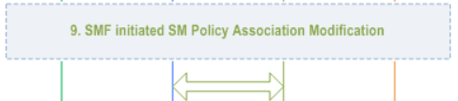
Step 9.
SMF may perform an SMF initiated SM Policy Association Modification procedure as defined in clause 4.16.5.1 to provide information on the Policy Control Request Trigger condition(s) that have been met. If Request Type is "initial request" and dynamic PCC is deployed and PDU Session Type is IPv4 or IPv6 or IPv4v6, SMF notifies the PCF (if the Policy Control Request Trigger condition is met) with the allocated UE IP address/prefix(es).
Notes:
SMF可能根據第4.16.5.1節所定義的方式進行SMF發起的SM Policy Association Modification procedure ，以提供有關已滿足的策略控制請求觸發條件的信息。如果請求類型為“initial request”，並且 dynamic PCC 已部署，並且 PDU Session Type 為 IPv4 或 IPv6 或 IPv4v6，SMF 將通知 PCF（如果 Policy Control Request 觸發條件已滿足），並提供分配的 UE IP address/prefix。

Slide 75
Step 9.
NOTE: If an IP address/prefix has been allocated before step 7 (e.g. subscribed static IP address/prefix in UDM/UDR) or the step 7 is performed after step 8, the IP address/prefix can be provided to PCF in step 7 and the IP address/prefix notification in this step can be skipped.
PCF may provide updated policies to the SMF. The PCF may provide policy information defined in clause 5.2.5.4 (and in TS 23.503) to SMF.
Notes:
如果在第7步之前已分配了 IP address/prefix （例如在 UDM/UDR 中訂閱的靜態IP地址/前綴），或者第8步在第7步之後執行，則可以在第7步將IP address/prefix 提供給 PCF，並且可以跳過此步驟中的IP address/prefix 通知。

Slide 76

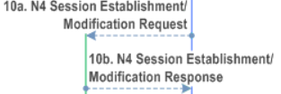
Step 10.
If Request Type indicates "initial request", the SMF initiates an N4 Session Establishment procedure with the selected UPF(s), otherwise it initiates an N4 Session Modification procedure with the selected UPF(s)

Slide 77
Step 10a.
The SMF sends an N4 Session Establishment/Modification Request to the UPF and provides Packet detection, enforcement and reporting rules to be installed on the UPF for this PDU Session.
If the SMF is configured to request IP address allocation from UPF as described in clause 5.8.2 of TS 23.501 then the SMF indicates to the UPF to perform the IP address/prefix allocation and includes the information required for the UPF to perform the allocation.
If the selective User Plane deactivation is required for this PDU Session, the SMF determines the Inactivity Timer and provides it to the UPF.
Notes:
SMF向UPF發送N4 會話建立/修改請求，並提供要在 UPF 上安裝的用於此 PDU session 的封包檢測、執行和報告規則。如果根據 TS 23.501 的第 5.8.2 條所述，SMF 被配置為從 UPF 請求 IP 地址分配，那麼 SMF 會向 UPF 指示執行 IP address/prefix 分配並包含 UPF 執行分配所需的信息。如果對於此 PDU 會話需要選擇性的用戶面停用，則 SMF 確定閒置計時器並將其提供給UPF。

Slide 78
Step 10a.
The SMF provides Trace Requirements to the UPF if it has received Trace Requirements. If the Reliable Data Service is enabled for the PDU Session by the SMF as specified in TS 23.501, the RDS Configuration information is provided to the UPF in this step.
The SMF provides Small Data Rate Control parameters to the UPF for the PDU Session, if required.
The SMF provides the Small Data Rate Control Status to the UPF, if received from the AMF.
If the Serving PLMN intends to enforce Serving PLMN Rate Control (see clause 5.31.14.2 of TS 23.501) for this PDU session then the SMF shall provide Serving PLMN Rate Control parameters to UPF for limiting the rate of downlink control plane data packets.
Notes:
如果SMF收到 Trace Requirements ，則向UPF提供 Trace Requirements 。如果SMF根據TS 23.501的規定啟用了 Reliable Data Service 的PDU會話，則在此步驟中向UPF提供RDS配置信息。如果需要，SMF向UPF提供PDU會話的 Small Data Rate Control parameters 。如果從 AMF 收到 Small Data Rate Control Status ，則SMF向UPF提供 Small Data Rate Control Status 。如果Serving PLMN 打算對此PDU session 執行 Serving PLMN Rate Control （參見TS 23.501的第5.31.14.2條），則SMF 應向 UPF 提供 Serving PLMN Rate Control parameters 以限制 DL CP packet 的 rate。

Slide 79
Step 10a.
For a PDU Session of type Ethernet or IP, the SMF (e.g. for a certain requested DNN/S-NSSAI for which Time Sensitive Networking, Time Sensitive Communications, Time Synchronization and Deterministic Networking is applicable) may include an indication to request UPF to provide a port number.
Notes:
對於Ethernet或IP類型的PDU session，（例如對於某些需要 Time Sensitive Networking, Time Sensitive Communications, Time Synchronization and Deterministic Networking 的特定 DNN/S-NSSAI）SMF 可以包含一個指示，要求UPF提供 port number。

Slide 80
Step 10a.
If SMF decides to perform redundant transmission for one or more QoS Flows of the PDU session as described in clause 5.33.2.2 of TS 23.501, two CN Tunnel Info are requested by the SMF from the UPF. The SMF also indicates the UPF to eliminate the duplicated packet for the QoS Flow in uplink direction. The SMF indicates the UPF that one CN Tunnel Info is used as the redundancy tunnel of the PDU session described in clause 5.33.2.2 of TS 23.501.
Notes:
如果SMF決定根據TS 23.501的第5.33.2.2條的規定對一個或多個PDU會話的QoS流進行 redundant transmission ，則SMF 向 UPF 請求兩個 CN Tunnel Info 。SMF 還指示 UPF 在上行方向上消除 QoS flow 的重複封包。SMF向UPF指示，一個CN Tunnel Info 被用作 TS 23.501的第5.33.2.2條所描述的PDU session 的 redundant transmission。

Slide 81
Step 10a.
If SMF decides to insert two I-UPFs between the PSA UPF and the NG-RAN for redundant transmission as described in clause 5.33.2.2 of TS 23.501, the SMF requests the corresponding CN Tunnel Info and provides them to the I-UPFs and PSA UPF respectively. The SMF also indicates the PSA UPF to eliminate the duplicated packet for the QoS Flow in uplink direction. The SMF indicates the PSA UPF that one CN Tunnel Info is used as the redundancy tunnel of the PDU session described in clause 5.33.2.2 of TS 23.501.
Notes:
如果SMF決定根據TS 23.501的第5.33.2.2條的規定，在PSA UPF和NG-RAN之間插入兩個I-UPF進行redundant transmission ，則SMF請求相應的CN Tunnel Info，並分別提供給I-UPF和PSA UPF。SMF還指示PSA UPF在上行方向上消除QoS flow 的重複封包。SMF向PSA UPF指示，一個 CN Tunnel Info 被用作TS 23.501的第5.33.2.2條所描述的PDU session的redundancy tunnel 。

Slide 82
Step 10a.
NOTE: The method to perform elimination and reordering on RAN/UPF based on the packets received from the two GTP-U tunnels is up to RAN/UPF implementation. The two GTP-U tunnels are terminated at the same RAN node and UPF.
Notes:
從兩個 GTP-U tunnel 接收的封包在 RAN/UPF上進行消除和重新排序的方法取決於 RAN/UPF 的實作。這兩個 GTP-U tunnel 的端點會接在同一個 RAN 節點和 UPF 上。

Slide 83
Step 10a.
If Control Plane CIoT 5GS Optimisation is enabled for this PDU session and the SMF selects the NEF as the anchor of this PDU Session in step 8, the SMF performs SMF-NEF Connection Establishment Procedure as described in clause 4.25.2.
If interworking with TSN deployed in the transport network is supported (see clause 4.4.8 of TS 23.501), the SMF includes a TL-Container with a get-request to the N4 Session Establishment or Modification request that is sent to the UPF, as described in clause 5.28a.2 of TS 23.501.
Notes:
如果支持與在 transport network 中部署的TSN進行互通（參見TS 23.501的第4.4.8條），則SMF 在發送給 UPF 的 N4 Session Establishment 或 Modification request 中包含一個 TL-Container，該 TL-Container 帶有一個 get-request，如 TS 23.501的第5.28a.2條所述。

Slide 84
Step 10b.
The UPF acknowledges by sending an N4 Session Establishment/Modification Response.
If the SMF indicates in step 10a that IP address/prefix allocation is to be performed by the UPF then this response contains the requested IP address/prefix. The requested CN Tunnel Info is provided to SMF in this step. If SMF indicated the UPF to perform packet duplication and elimination for the QoS Flow in step 10a, two CN Tunnel Info are allocated by the UPF and provided to the SMF. If SMF decides to insert two I-UPFs between the PSA UPF and the NG-RAN for redundant transmission as described in clause 5.33.2.2 of TS 23.501, CN Tunnel Info of two I-UPFs and the UPF (PSA) are allocated by the UPFs and provided to the SMF. The UPF indicates the SMF that one CN Tunnel Info is used as the redundancy tunnel of the PDU session as described in clause 5.33.2.2 of TS 23.501.
Notes:
UPF通過發送 N4 Session Establishment/Modification Response 來進行確認。
如果SMF在第10a步中指示UPF執行IP address/prefix 分配，則此 response 將包含請求的IP address/prefix 。請求的CN隧道信息在此步驟中提供給SMF。如果SMF在第10a步中指示UPF對QoS流執行封包重複和消除，則UPF將分配兩個 CN Tunnel Info 並提供給SMF。如果SMF決定在PSA UPF和NG-RAN之間插入兩個I-UPF進行 redundancy tunnel（如TS 23.501的第5.33.2.2條所述），則UPF 將分配兩個 I-UPF 和 UPF（PSA）的 CN Tunnel Info 並提供給 SMF。UPF向SMF指示，一個 CN Tunnel Info 被用作TS 23.501的第5.33.2.2條所描述的PDU 會話的 redundancy tunnel。

Slide 85
Step 10b.
If SMF requested UPF to provide a port number then UPF includes the port number and user-plane Node ID in the response according to TS 23.501. To support integration with IEEE TSN, the user-plane node ID is Bridge ID. Besides the network instance, the SMF may also provide DNN/S-NSSAI for the UPF to respond with user-plane Node ID based on pre-configuration information.
If multiple UPFs are selected for the PDU Session, the SMF initiate N4 Session Establishment/Modification procedure with each UPF of the PDU Session in this step.
Notes:
如果SMF要求UPF提供 port number，則UPF根據TS 23.501的規定在響應中包含 port number 和 user-plane Node ID 。為了支持與IEEE TSN的集成，用戶面 user-plane Node ID 是 Bridge ID。除了網絡實例之外，SMF還可以向UPF提供DNN/S-NSSAI，以便UPF根據預配置信息回復 user-plane Node ID 。
如果為PDU session選擇了多個UPF，則在此步驟中，SMF將與PDU session的每個UPF分別啟動 N4 Session Establishment/Modification 。

Slide 86
Step 10b.
NOTE: If the PCF has subscribed to the UE IP address change Policy Control Trigger (as specified in clause 6.1.3.5 of TS 23.503) then the SMF notifies the PCF about the IP address/prefix allocated by the UPF. This is not shown in Figure 4.3.2.2.1-1.
Notes:
如果PCF訂閱了UE IP addreses更改Policy Control Trigger（如TS 23.503的第6.1.3.5條所指定），那麼SMF將通知PCF有關UPF分配的IP address/prefix 。這在圖4.3.2.2.1-1中沒有顯示出來。

Slide 87
Step 10b.
If interworking with TSN deployed in the transport network is supported and the UPF supports CN-TL and received a TL-Container with a get-request from the SMF/CUC in step 10a (see clause 4.4.8 of TS 23.501), the UPF/CN-TL includes a TL-Container with a get-response in the N4 Session Establishment or Modification response, as described in clause 5.28a.2 of TS 23.501. The SMF/CUC stores the get-response.
Notes:
如果支持與在傳輸網絡中部署的TSN進行互通，且UPF支持CN-TL，在第10a步中從SMF/CUC接收到帶有get-request 的 TL-Container（參見TS 23.501的第4.4.8條），UPF/CN-TL 將在 N4 Session Establishment or Modification response 中包含帶有 get-response 的 TL-Container，如TS 23.501的第5.28a.2條所述。SMF/CUC將存儲get-response的內容。
CUC: Centralized User Configuration
TL: talker-listener

Slide 88


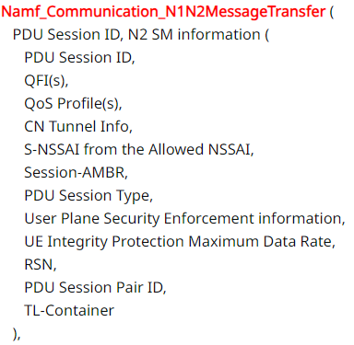
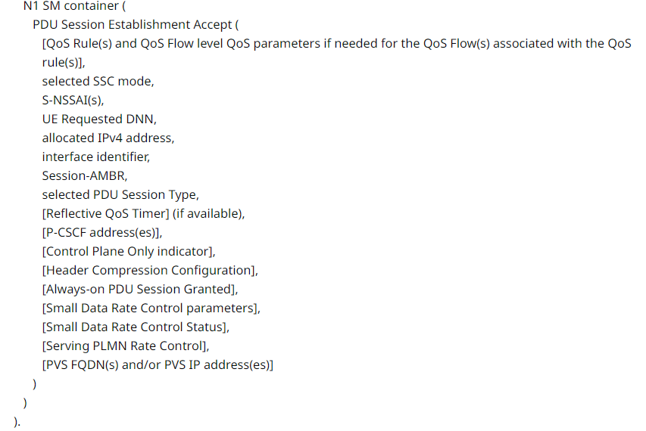
Step 11.

Slide 89
Step 11.
If multiple UPFs are used for the PDU Session, the CN Tunnel Info contains tunnel information related with the UPFs that terminate N3.
The SMF may provide the SMF derived CN assisted RAN parameters tuning to the AMF by invoking Nsmf_PDUSession_SMContextStatusNotify (SMF derived CN assisted RAN parameters tuning) service. The AMF stores the SMF derived CN assisted RAN parameters tuning in the associated PDU Session context for this UE.
Notes:
如果在PDU session中使用多個UPF，則CN tunnel info將包含與終止N3的UPF相關的隧道信息。
SMF可以通過調用Nsmf_PDUSession_SMContextStatusNotify（SMF衍生的CN輔助RAN參數調整）服務，將SMF衍生的CN assisted RAN parameters調整信息提供給AMF。AMF將在與該UE相關聯的PDU session context 中存儲 SMF 衍生的 CN assisted RAN parameters調整。

Slide 90
Step 11.
The N2 SM information carries information that the AMF shall forward to the (R)AN which includes
The CN Tunnel Info corresponds to the Core Network address(es) of the N3 tunnel corresponding to the PDU Session. If two CN Tunnel Info are included for the PDU session for redundant transmission, the SMF also indicates the NG-RAN that one of the CN Tunnel Info used as the redundancy tunnel of the PDU session as described in clause 5.33.2.2 of TS 23.501.
One or multiple QoS profiles and the corresponding QFIs can be provided to the (R)AN. This is further described in clause 5.7 of TS 23.501. The SMF may indicate for each QoS Flow whether redundant transmission shall be performed by a corresponding redundant transmission indicator.
The PDU Session ID may be used by AN signalling with the UE to indicate to the UE the association between (R)AN resources and a PDU Session for the UE.
(next page)
Notes:
N2 SM information 透過 AMF 攜帶給 RAN 的資訊應包含下列:
CN Tunnel Info 對應於與PDU session相對應的N3 tunnel的 CN address。如果為PDU session包括了兩個CN隧道信息以進行冗餘傳輸，則SMF還向NG-RAN指示其中一個 CN Tunnel Info 被用作TS 23.501的第5.33.2.2條所描述的PDU session 的 redundant transmission。
可以向（R）AN 提供一個或多個QoS配置文件及其對應的QFI。這在TS 23.501的第5.7條中有進一步描述。SMF可以通過相應的redundant transmission indicator，為每個QoS流指示是否應該進行 redundant transmission 。
PDU session ID可以由AN與UE 進行 signaling 時使用，以向UE指示(R)AN資源與UE的PDU會話之間的關聯。

Slide 91
Step 11.
The N2 SM information carries information that the AMF shall forward to the (R)AN which includes
A PDU Session is associated to an S-NSSAI of the HPLMN and, if applicable, to a S-NSSAI of the VPLMN and a DNN. The S-NSSAI provided to the (R)AN, is the S-NSSAI with the value for the Serving PLMN (i.e. the HPLMN S-NSSAI or, in LBO roaming case, the VPLMN S-NSSAI).
User Plane Security Enforcement information is determined by the SMF as described in clause 5.10.3 of TS 23.501.
If the User Plane Security Enforcement information indicates that Integrity Protection is "Preferred" or "Required", the SMF also includes the UE Integrity Protection Maximum Data Rate as received in the PDU Session Establishment Request.
The use of the RSN parameter and the PDU Session Pair ID by NG-RAN are described in clause 5.33.2.1 of TS 23.501.
TL-Container as described in clause 5.28a.2 of TS 23.501. If interworking with TSN deployed in the transport network is supported (see clause 4.4.8 of TS 23.501), the SMF includes a TL-Container with a get-request to the N2 SM information, as described in clause 5.28a.2 of TS 23.501.
Notes:
一個PDU會話與HPLMN的一個S-NSSAI相關聯，如果適用的話，還與VPLMN的一個S-NSSAI和DNN相關聯。提供給(R)AN的S-NSSAI是具有Serving PLMN的值的S-NSSAI（即HPLMN的S-NSSAI，或在LBO漫遊情況下是VPLMN的S-NSSAI）。
User Plane Security Enforcement information由SMF根據《TS 23.501》第5.10.3條的描述決定。
如果使用者面安全執行資訊指示完整性保護為「Preferred」或「Required」，SMF還會在收到的PDU Session Establishment Request中包含UE Integrity Protection Maximum Data Rate。
《TS 23.501》的第5.33.2.1條描述了NG-RAN使用RSN參數和PDU session pair ID的使用方式。
《TS 23.501》的第5.28a.2條描述了TL-Container的使用方式。如果支援與部署在傳輸網絡中的TSN進行互通（參見《TS 23.501》的第4.4.8條），SMF將包含一個帶有get-request的TL-Container來獲取N2 SM資訊，詳細內容在《TS 23.501》的第5.28a.2條中有描述。

Slide 92
Step 11.
The N1 SM container contains the PDU Session Establishment Accept that the AMF shall provide to the UE. If the UE requested P-CSCF discovery then the message shall also include the P-CSCF IP address(es) as determined by the SMF and as described in clause 5.16.3.4 of TS 23.501. The PDU Session Establishment Accept includes S-NSSAI from the Allowed NSSAI. For LBO roaming scenario, the PDU Session Establishment Accept includes the S-NSSAI from the Allowed NSSAI for the VPLMN and also it includes the corresponding S-NSSAI of the HPLMN from the Mapping Of Allowed NSSAI that SMF received in step 3.
Notes:
N1 SM container 包含AMF應提供給UE的PDU Session Establishment Accept消息。如果UE要求P-CSCF發現，則該消息還應包括由SMF確定並按照《TS 23.501》第5.16.3.4條描述的P-CSCF IP位址。PDU Session Establishment Accept消息包括從 Allowed NSSAI中的S-NSSAI。對於LBO roaming 場景，PDU Session Establishment Accept 消息包括來自VPLMN的 Allowed NSSAI中的S-NSSAI，並且還包括SMF在第3步收到的 Mapping Of Allowed NSSAI對應的HPLMN的S-NSSAI。

Slide 93
Step 11.
(skip)
Notes:
步驟11剩餘的部分太過瑣碎所以跳過

Slide 94


Step 12.
AMF to (R)AN: N2 PDU Session Request
N2 SM information
NAS message
PDU Session ID
N1 SM container (PDU Session Establishment Accept),
[CN assisted RAN parameters tuning]
Notes:
步驟12是AMF到RAN 的 N2 PDU Session Request ，包含:
- N2 SM information
- NAS message
- [CN assisted RAN parameters tuning]

Slide 95
Step 12.
The AMF sends the NAS message containing PDU Session ID and PDU Session Establishment Accept targeted to the UE and the N2 SM information received from the SMF within the N2 PDU Session Request to the (R)AN.
If the SMF derived CN assisted RAN parameters tuning are stored for the activated PDU Session(s), the AMF may derive updated CN assisted RAN parameters tuning and provide them the (R)AN.
Notes:
AMF向UE發送包含PDU會話ID和針對UE的PDU會話建立接受的NAS消息，以及從SMF收到的N2 PDU會話請求中的N2 SM信息，該消息發送給(R)AN。
如果SMF導出的CN assisted RAN parameters tuning已經存儲於activated PDU Session中，則AMF可以推導出更新後的 CN assisted RAN parameters tuning 並提供給(R)AN。

Slide 96


Step 13.
(R)AN to UE: The (R)AN may issue AN specific signalling exchange with the UE that is related with the information received from SMF. For example, in the case of a NG-RAN, an RRC Connection Reconfiguration may take place with the UE establishing the necessary NG-RAN resources related to the QoS Rules for the PDU Session request received in step 12.
Notes:
第13步是 RAN to UE 的 AN-specific resource setup
(R)AN可以與UE進行與從SMF接收到的信息相關的AN特定信令交換。例如，在NG-RAN的情況下，可以通過RRC連接重配置與UE進行交互，以建立與PDU會話請求相關的必要NG-RAN資源和QoS規則。

Slide 97
Step 13.
(R)AN also allocates (R)AN Tunnel Info for the PDU Session. In the case of Dual Connectivity, the Master RAN node may assign some (zero or more) QFIs to be setup to a Master RAN node and others to the Secondary RAN node. The AN Tunnel Info includes a tunnel endpoint for each involved (R)AN node and the QFIs assigned to each tunnel endpoint. A QFI can be assigned to either the Master RAN node or the Secondary RAN node and not to both.
Notes:
在PDU會話中，(R)AN還分配(R)AN隧道信息。在雙連接的情況下，主RAN節點可以將一些（零個或多個）QFI分配給主RAN節點，而將其他QFI分配給次要RAN節點。AN隧道信息包括每個涉及的(R)AN節點的隧道端點以及分配給每個隧道端點的QFI。一個QFI可以分配給主RAN節點或次要RAN節點，但不能同時分配給兩者。

Slide 98
Step 13.
If the (R)AN receives two CN Tunnel Info for a PDU session in step 12 for redundant transmission, (R)AN also allocates two AN Tunnel Info correspondingly and indicate to SMF one of the AN Tunnel Info is used as the redundancy tunnel of the PDU session as described in clause 5.33.2.2 of TS 23.501.
Notes:
如果在第12步中，(R)AN收到一個PDU會話的兩個CN隧道信息，用於冗餘傳輸，那麼(R)AN也相應地分配兩個AN隧道信息，並且根據TS 23.501中的第5.33.2.2條款，向SMF指示其中一個AN隧道信息用作該PDU會話的冗餘隧道。

Slide 99
Step 13.
(R)AN forwards the NAS message (PDU Session ID, N1 SM container (PDU Session Establishment Accept)) provided in step 12 to the UE. (R)AN shall only provide the NAS message to the UE if the AN specific signalling exchange with the UE includes the (R)AN resource additions associated to the received N2 command.
Notes:
(R)AN將在第12步中提供的NAS message (PDU Session ID, N1 SM container (PDU Session Establishment Accept))轉發給UE。僅當與UE的AN specific signalling 交換中包括與接收到的N2命令相關聯的（R）AN資源添加時，（R）AN才將NAS消息提供給UE。

Slide 100
Step 13.
If MICO mode is active and the NAS message Request Type in step 1 indicated "Emergency Request", then the UE and the AMF shall locally deactivate MICO mode.
If the N2 SM information is not included in the step 11, then the following steps 14 to 16b and step 17 are omitted.
Notes:
如果MICO模式處於活動狀態且步驟1中的NAS消息請求類型指示為“緊急請求”，則UE和AMF應在本地停用MICO模式。
如果步驟11中未包含N2 SM info，則省略以下步驟14至16b以及步驟17。

Slide 101


Step 14.
N2 PDU Session Response
PDU Session ID
Cause
N2 SM information
PDU Session ID
AN Tunnel Info
List of accepted/rejected QFI(s)
User Plane Enforcement Policy Notification
TL-Container
Notes:
N2 PDU Session Response 包含了以下資訊:
PDU Session ID
Cause
N2 SM information
PDU Session ID
AN Tunnel Info
List of accepted/rejected QFI(s)
User Plane Enforcement Policy Notification
TL-Container
TL: talker-listener
CUC: Centralized User Configuration

Slide 102
Step 14.
The AN Tunnel Info corresponds to the Access Network address of the N3 tunnel corresponding to the PDU Session.
The (R)AN may reject the addition or modification of a QoS Flow, e.g. due to handling of the UE-Slice-MBR as described in clause 5.7.1.10 of TS 23.501. If the (R)AN rejects QFI(s) the SMF is responsible of updating the QoS rules and QoS Flow level QoS parameters associated to the rejected QoS Flow(s) in the UE accordingly.
Notes:
AN Tunnel Info 是對應於與 PDU Session 的相對應的 N3 tunnel 的 Access Network address。
(R)AN 可能會拒絕添加或修改 QoS Flow，例如由於處理 UE-Slice-MBR 而拒絕。如果 (R)AN 拒絕了 QFI，則 SMF 負責相應地更新與被拒絕的 QoS Flow 相關聯的 QoS rule 和 QoS Flow level QoS parameters。

Slide 103
Step 14.
The NG-RAN rejects the establishment of UP resources for the PDU Session when it cannot fulfil User Plane Security Enforcement information with a value of Required. The NG-RAN notifies the SMF when it cannot fulfil a User Plane Security Enforcement with a value of Preferred.
Notes:
當 NG-RAN 無法滿足帶有 Required 值的 User Plane Security Enforcement 時，它會拒絕建立 PDU Session 的 User plane resources 。當 NG-RAN 無法滿足帶有 Preferred 值的 User Plane Security Enforcement 時，它會通知 SMF 。

Slide 104
Step 14.
If the NG-RAN cannot establish redundant user plane for the PDU Session as indicated by the RSN parameter and PDU Session Pair ID, the NG-RAN takes the decision on whether to reject the establishment of RAN resources for the PDU Session based on local policies as described in TS 23.501.
Notes:
如果 NG-RAN 不能根據 RSN 參數和 PDU Session Pair ID 建立冗餘的用戶面資源，NG-RAN 將根據本地策略決定是否拒絕建立 PDU Session 的 RAN 資源。這一情況在 TS 23.501 中有詳細描述。

Slide 105
Step 14.
If interworking with TSN deployed in the transport network is supported and the NG-RAN supports AN-TL and received a TL-Container with a get-request from the SMF/CUC in step 12 (see clause 4.4.8 of TS 23.501), the NG-RAN/AN-TL includes a TL-Container with a get-response to the N2 SM information, as described in clause 5.28a.2 of TS 23.501.
Notes:
如果支持與部署在傳輸網絡中的 TSN 進行互通，並且 NG-RAN 支持 AN-TL，在步驟 12 中從 SMF/CUC 收到 TL-Container 的 get-request（參見 TS 23.501 的第 4.4.8 節），NG-RAN/AN-TL 將包含一個內含 get-response 的 TL-Container 進 N2 SM information，正如 TS 23.501 的第 5.28a.2 節所描述。
CUC: Centralized User Configuration

Slide 106

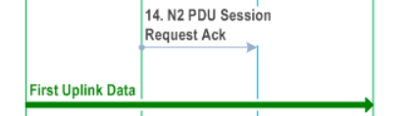
Step 14.

Slide 107


Step 15.
Nsmf_PDUSession_UpdateSMContext Request
SM Context ID
N2 SM information
Request Type
If the list of rejected QFI(s) is included in N2 SM information, the SMF shall release the rejected QFI(s) associated QoS profiles.

Slide 108
Step 15.
If the N2 SM information indicates failure of user plane resource setup,
the SMF shall reject the PDU session establishment by including a N1 SM container with a PDU Session Establishment Reject message (see clause 8.3.3 of TS 24.501) in the Nsmf_PDUSession_UpdateSMContext Response in step 17.
Step 16 is skipped in this case and instead the SMF releases the N4 Session with UPF.
Notes:
如果 N2 SM 信息顯示 user plane resource setup 失敗，則 SMF 將在步驟 17 中通過在 Nsmf_PDUSession_UpdateSMContext response 中包含帶有 PDU Session Establishment Reject 消息的 N1 SM Container，來拒絕 PDU session 的建立。在這種情況下，將跳過步驟 16，而 SMF 會釋放與 UPF 的 N4 會話。

Slide 109
Step 15.
If the User Plane Enforcement Policy Notification in the N2 SM information indicates that no user plane resources could be established and the User Plane Enforcement Policy indicated "required" as described in clause 5.10.3 of TS 23.501,
the SMF shall reject the PDU session establishment by including a N1 SM container with a PDU Session Establishment Reject message (see clause 8.3.3 of TS 24.501) in the Nsmf_PDUSession_UpdateSMContext Response in step 17.
Step 16 is skipped in this case.
Notes:
如果 N2 SM 信息顯示 user plane resource setup 失敗，則 SMF 將在步驟 17 中通過在 Nsmf_PDUSession_UpdateSMContext response 中包含帶有 PDU Session Establishment Reject 消息的 N1 SM Container，來拒絕 PDU session 的建立。在這種情況下，將跳過步驟 16，而 SMF 會釋放與 UPF 的 N4 會話。

Slide 110
Step 15.
If the N2 SM information includes a TL-Container with a get-response as described in clause 5.28a.2 of TS 23.501, the SMF/CUC stores the get-response.
Notes:
如果 N2 SM info 包含了具有 get-response 的 TL-Container ，則 SMF/CUC 將儲存這個 get-response。

Slide 111

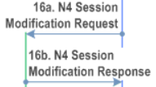
Step 16a.
The SMF initiates an N4 Session Modification procedure with the UPF. The SMF provides AN Tunnel Info to the UPF as well as the corresponding forwarding rules.
If SMF decides to perform redundant transmission for one or more QoS Flows of the PDU, the SMF also indicates the UPF to perform packet duplication for the QoS Flow(s) in downlink direction by forwarding rules.
Notes:
SMF 向 UPF 發起 N4 Session Modification procedure 。SMF 向 UPF 提供 AN Tunnel Info 以及相應的 forwarding rules。
如果 SMF 決定對 PDU 的一個或多個 QoS flow 進行 redundant transmission，SMF 還通過 forwarding rule 指示 UPF 在下行方向上對 QoS flow 進行封包複製。

Slide 112
Step 16a.
In the case of redundant transmission with two I-UPFs for one or more QoS Flows of the PDU, the SMF provides AN Tunnel Info to two I-UPFs and also indicates the UPF (PSA) to perform packet duplication for the QoS Flow(s) in downlink direction by forwarding rules. The SMF also provides the UL Tunnel Info of the UPF (PSA) to the two I-UPFs and the DL Tunnel Info of the two I-UPFs to the UPF (PSA).
UPF 1
RAN
UPF (PSA)
UPF 2
Notes:
在使用兩個 I-UPF 進行 redundant transmission 的情況下，對於 PDU 的一個或多個 QoS flow，SMF 將 AN Tunnel Info 提供給兩個 I-UPF，並且通過 forwarding rules 指示 UPF（PSA）在下行方向對 QoS flow 進行封包複製。SMF 還將 UPF（PSA）的 UL Tunnel Info 提供給兩個 I-UPF，並將兩個 I-UPF 的 DL Tunnel Info 提供給 UPF（PSA）。

Slide 113
Step 16b.
The UPF provides an N4 Session Modification Response to the SMF.
If multiple UPFs are used in the PDU Session, the UPF in step 16 refers to the UPF terminating N3.
Notes:
步驟16b，UPF 傳送 N4 Session Modification Response SMF。
若 PDU Session 使用多個 UPFs，則此步驟的 UPF 為 UPF terminating N3。
此步驟之後，UPF 會運送任何在這個 PDU Session 中被 buffer 的 DL packets 給 UE。

Slide 114


Step 16c.
If Request Type indicates neither "Emergency Request" nor "Existing Emergency PDU Session" and, if the SMF has not yet registered for this PDU Session, then the SMF registers with the UDM using Nudm_UECM_Registration (SUPI, DNN, S-NSSAI of HPLMN, PDU Session ID, SMF Identity, Serving Node PLMN ID, [NID]) for a given PDU Session.
As a result, the UDM stores following information: SUPI, SMF identity and the associated DNN, S-NSSAI of HPLMN, PDU Session ID and Serving Network (PLMN ID, [NID], see clause 5.18 of TS 23.501).
Notes:
如果步驟3中的請求類型既不是 Emergency Request 也不是 Existing Emergency PDU Session，且如果 SMF 尚未為此 PDU Session 進行註冊，則 SMF 將使用 Nudm_UECM_Registration 包含 SUPI、DNN、HPLMN 的 S-NSSAI、PDU Session ID、SMF Identity、Serving Node PLMN ID、[NID] 這些資訊，向 UDM 進行註冊，針對給定的 PDU Session。
於是，UDM 將儲存以下信息：SUPI、SMF identity 及相關的 DNN、HPLMN 的 S-NSSAI、PDU Session ID 和 Serving Network（PLMN ID、[NID]，參見TS 23.501的5.18節）。UDM還可以通過Nudr_DM_Update（SUPI、訂閱數據、SMF數據中的UE上下文）將此信息進一步存儲在UDR中。

Slide 115
Step 16c.
The UDM may further store this information in UDR by Nudr_DM_Update (SUPI, Subscription Data, UE context in SMF data).
If the UDM has existing applicable event exposure subscriptions for events detected in SMF for this UE or any of the groups this UE belongs to (possibly retrieved from UDR), UDM invokes the Nsmf_EventExposure_Subscribe service for creating the event exposure subscriptions.
Notes:
UDM 可使用 Nudr_DM_Update 裡面包含 SUPI、Subscription Data、UE context in SMF data，將這些資訊進一步儲存在UDR中。
如果 UDM 對於 SMF 在該 UE 或該 UE 所屬的任何群組中檢測到已存在的 event exposure subscriptions (可能是從 UDR 那裡獲取的)，UDM將調用 Nsmf_EventExposure_Subscribe 服務來建立 event exposure subscriptions。

Slide 116
Step 16c.
If the Request Type indicates "Emergency Request":
For an authenticated non-roaming UE, based on operator configuration (e.g. related with whether the operator uses a fixed SMF for Emergency calls, etc.), the SMF may register in the UDM using Nudm_UECM_Registration (SUPI, PDU Session ID, SMF identity, Indication of Emergency Services) for a given PDU Session that is applicable for emergency services. As a result, the UDM shall store the applicable PDU Session for Emergency services.
For an unauthenticated UE or a roaming UE, the SMF shall not register in the UDM for a given PDU Session.
Notes:
如果 Request Type 為 Emergency Request
對於已驗證的非漫遊 UE，基於運營商的設定（例如，運營商是否對緊急呼叫使用固定的SMF等），SMF 可能會使用 Nudm_UECM_Registration（SUPI，PDU Session ID，SMF身份，緊急服務指示）在 UDM 中進行註冊，針對適用於緊急服務的特定 PDU Session。使 UDM 必須儲存此適用於緊急服務的 PDU Session。
對於未驗證的UE或漫遊UE，SMF不應該針對給定的PDU Session在UDM中進行註冊。

Slide 117

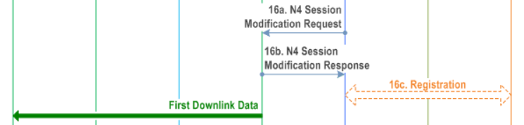
After Step 16.
After this step, the UPF delivers any down-link packets to the UE that may have been buffered for this PDU Session.
Notes:
在步驟 16 完成後，UPF 就可以運送任何在這個 PDU Session 中被 buffer 的 DL packets 給 UE。

Slide 118

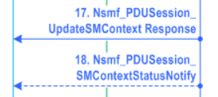
Step 17.
Nsmf_PDUSession_UpdateSMContext Response (Cause)
The SMF may subscribe to the UE mobility event notification from the AMF (e.g. location reporting, UE moving into or out of Area Of Interest), after this step by invoking Namf_EventExposure_Subscribe service operation as specified in clause 5.2.2.3.2.
For LADN, the SMF subscribes to the UE moving into or out of LADN service area event notification by providing the LADN DNN as an indicator for the Area Of Interest (see clause 5.6.5 and 5.6.11 of TS 23.501).
After this step, the AMF forwards relevant events subscribed by the SMF.
Notes:
步驟 17，SMF 回傳 Nsmf_PDUSession_UpdateSMContext Response 給 AMF。
在這個步驟之後，SMF可以通過調用 Namf_EventExposure_Subscribe 服務操作來訂閱來自 AMF 的 UE mobility event notification（例如位置報告、UE 進入或離開 Area Of Interest）。
對於LADN，SMF 通過提供 LADN DNN 作為 Area Of Interest 的 indicator，來訂閱 UE 進入或離開 LADN service area event notification。
在這個步驟之後，AMF將轉發SMF訂閱的相關事件。

Slide 119
Step 18. (Conditional)
If during the procedure, any time after step 5, the PDU Session establishment is not successful, the SMF informs the AMF by invoking Nsmf_PDUSession_SMContextStatusNotify (Release).
The SMF also releases
any N4 session(s) created,
any PDU Session address if allocated (e.g. IP address) and
the association with PCF, if any.
In this case, step 19 is skipped.
Notes:
步驟 18，如果在步驟5之後的任何時候，PDU Session 建立不成功，SMF 通過調用 Nsmf_PDUSession_SMContextStatusNotify 來通知 AMF。
SMF 也會釋放:
任何被建立起來的 N4 Session，及
任何 PDU Session address (例如 IP address)，及
與 PCF 的 association
此 case 之下 步驟 19 將被跳過。

Slide 120

Step 19.
In the case of PDU Session Type IPv6 or IPv4v6, the SMF generates an IPv6 Router Advertisement and sends it to the UE.
If Control Plane CIoT 5GS Optimisation is enabled for this PDU Session the SMF sends the IPv6 Router Advertisement for transmission to the UE using the Mobile Terminated Data via the AMF Transport in Control Plane CIoT 5GS Optimisation procedures (see clause 4.24.2),
otherwise the SMF sends the IPv6 Router Advertisement via N4 and the UPF.
Notes:
在PDU Session類型為IPv6或IPv4v6的情況下，SMF生成一個 IPv6 Router Advertisement 並將其發送給UE。如果為此 PDU Session 啟用了 Control Plane CIoT 5GS Optimisation ，SMF 使用 Control Plane CIoT 5GS Optimisation procedure 中的 AMF Transport 通過 Mobile Terminated Data 將 IPv6 Router Advertisement 發送給 UE（參見第4.24.2節）。否則，SMF 通過 N4 和 UP F發送 IPv6 Router Advertisement。

Slide 121


Step 20.
When the trigger for 5GS Bridge/Router information available is armed, then the SMF may initiate the SM Policy Association Modification as described in clause 4.16.5.1.

Slide 122
Step 20.
If the UE has indicated support of transferring Port Management Information Containers, then SMF informs PCF that 5GS Bridge/Router information is available.
In the case of Deterministic Networking, the SMF may also provide the MTU size for IPv4 or IPv6.
If the SMF received a Port Management Information Container from either the UE or the UPF, then the SMF provides the Port Management Information Container and port number of the related port to the PCF as described in clause 5.28.3.2 of TS 23.501.
Notes:
如果UE表示支持 Port Management Information Containers，那麼SMF將通知PCF可用的 5GS Bridge/Router information。在確定性網絡的情況下，SMF還可以提供IPv4的MTU大小或IPv6的MTU大小。如果SMF從UE或UPF收到Port Management Information Container ，則SMF將根據TS 23.501第5.28.3.2節的描述，向PCF提供相關 port 的 Port Management Information Container 以及 port number。

Slide 123
Step 20.
5GS Bridge/Router information
5GS user-plane Node ID,
port number for the PDU session,
MAC address of the DS-TT Ethernet port for Ethernet PDU Session type,
UE IP address for IP PDU Session type
UE-DS-TT Residence Time (if available) as provided by the UE
Notes:
5GS Bridge/Router information 包含以下資訊:
5GS user-plane Node ID,
port number for the PDU session,
MAC address of the DS-TT Ethernet port for Ethernet PDU Session type,
UE IP address for IP PDU Session type
UE-DS-TT Residence Time (if available) as provided by the UE

Slide 124
Step 20.
If the SMF has received User Plane Node Management Information from the UPF, then the SMF provides the User Plane Node Management Information Container to the PCF as part of 5GS Bridge/Router information and as described in clause 5.28.3.2 of TS 23.501.
Notes:
如果SMF從UPF收到了 User Plane Node Management Information ，則SMF將根據TS 23.501第5.28.3.2節的描述，將用戶面節點管理信息容器作為5GS橋接/路由器信息的一部分提供給PCF。

Slide 125
Step 20.
To support IEEE TSN, the TSN AF calculates the bridge delay for each port pair, i.e. composed of DS-TT Ethernet port and NW-TT Ethernet port, using the UE-DS-TT Residence Time for all NW-TT Ethernet port(s) serving the 5GS Bridge indicated by the 5GS user-plane Node ID. Additionally, the TSN AF determines the 5GS bridge delay for port pair composed of two DS-TT ports connecting to the same 5GS Bridge as sum of bridge delays related to PDU Sessions of the two DS-TT ports.
Notes:
為支持 IEEE TSN，TSN AF 使用 UE-DS-TT 駐留時間計算每個 port pair 的橋接延遲，這些port pair 由 DS-TT 以太網口和 NW-TT 以太網口組成，並且所有 NW-TT 以太網口服務的 5GS 橋接由 5GS user-plane Node ID 指示。此外，TSN AF 通過將與兩個 DS-TT 端口的 PDU Session 相關的橋接延遲相加，確定兩個 DS-TT 端口連接到同一個 5GS 橋接的 port pair 的 5GS 橋接延遲。

Slide 126


Step 21.
If the PDU Session establishment failed after step 4, the SMF shall perform the following:
The SMF unsubscribes to the modifications of Session Management Subscription data for the corresponding (SUPI, DNN, S-NSSAI of the HPLMN), using Nudm_SDM_Unsubscribe (SUPI, Session Management Subscription data, DNN, S-NSSAI of the HPLMN), if the SMF is no more handling a PDU Session of the UE for this (DNN, S-NSSAI of the HPLMN).
The UDM may unsubscribe to the modification notification from UDR by Nudr_DM_Unsubscribe (SUPI, Subscription Data, Session Management Subscription data, S-NSSAI of the HPLMN, DNN).
Notes:
如果在步驟4之後 PDU Session 的建立失敗，SMF 應執行以下操作：
如果 SMF 不再處理該 UE 在此 (DNN，S-NSSAI of the HPLMN) 下的 PDU Session，則使用 Nudm_SDM_Unsubscribe（SUPI，Session Management Subscription data，DNN，S-NSSAI of the HPLMN）取消訂閱對應的（SUPI，DNN，S-NSSAI of the HPLMN）的 Session Management Subscription data 的修改。
如果 UDM 不再需要接收 UDR 的修改通知，則使用 Nudr_DM_Unsubscribe（SUPI，Subscription Data，Session Management Subscription data，S-NSSAI of the HPLMN，DNN）取消訂閱 UDR 的修改通知。

